Slide 1
Software Workshop 2:
Lighting Effects Using FastLED
Liz Willer
15/10/2019

Slide 2
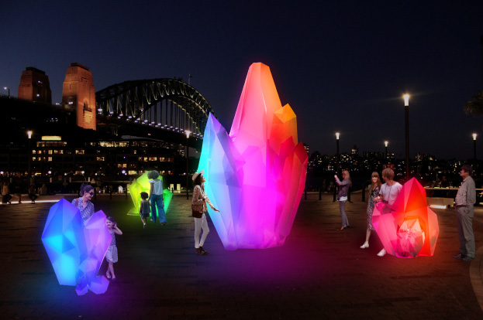
UNSW Illuminate

Slide 3
The Aly Boards
VCC
Data
Ground

Slide 4
The FastLED Library
#include <FastLED.h>
#includes and global vars
Include the library
Make an array
Set up the library
Reduce brightness
Fill the array
Send the data
FastLED.addLeds<WS2811, DATA_PIN, GRB>(leds, NUM_LEDS);
Setup
FastLED.setBrightness(BRIGHTNESS);
Loop
FastLED.show();
FastLED.show();

Slide 5
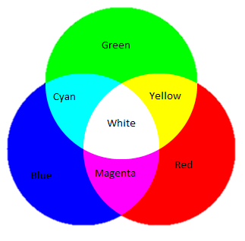
RGB
Notes:
Image from: https://www.teachengineering.org/makerchallenges/view/spfun_rgbcolor_maker1

Slide 6
Setting the Colour
leds[i].r = 255;
leds[i].g = 68;
leds[i].b = 221;
CRGB leds[NUM_LEDS];
leds[i].setRGB( 255, 68, 221);
leds[i] = 0xFF44DD;
leds[0] = CRGB::Red;
More info: https://github.com/FastLED/FastLED/wiki/Controlling-leds

Slide 7
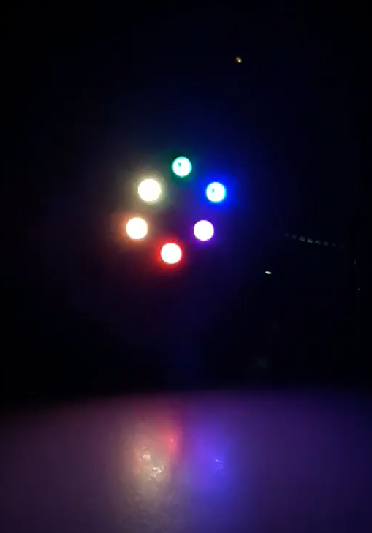
Your Task
Starter code can be found at:
https://github.com/liz-liz/IlluminateSoftwareWorkshops/blob/master/Blink.ino

Slide 8
Challenge!
You have until 7:45pm to make your prettiest light show
Winner gets a prize

